Slide 1
A Brief Progress Review on ASR in ICASSP2020
Yanmin Qian
Shanghai Jiao Tong University
13-June-2020

Slide 2
Main Info
~200 session in ICASSP, and 69 sessions on Audio, Speech and Language
21 for Audio-AUD
40 for Speech-SPE
8 for Language-HLT
Speech processing is one main theme in ICASSP lasting for a long time
13 for Speech Recognition
6 for Speaker, Spoofing and Diarization
7 for enhancement and separation
6 for text-to-speech
5 for music
9 for others

Slide 3
Main Info
Speech recognition is still the most important task in signal processing and machine learning
5 lecture sessions and 8 poster sessions
Categories in ASR
3 sessions for end-to-end ASR
6 sessions for AM in ASR
4 session for LM, architecture, search, decoding

Slide 4
Main Info
Hot topics in ASR
End-to-end ASR is still hot and commonly used in ASR
End-to-end Speech Recognition I: Streaming
End-to-end Speech Recognition II: New Models
End-to-end Speech Recognition III: General Topics
E2E models have been used as the basic architecture in most ASR papers
Robust is still important and challenging, and more than 30 papers are focusing on robustness of ASR
Robust speech recognition
Speech recognition: Adaptation

Slide 5
End-to-End ASR
Comparison with previous years
3 session and 24 papers this year, and 9 from Google
5 session and 38 papers in ICASSP2019
2 session and 16 papers in ICASSP2018
Peak last year, and seem go down now?
Actually used as the basic modeling arch for most ASR papers
Topics in E2E ASR this year
Streaming
6 papers, 2 with RNNT and 4 with Attention
Google: two-pass model (Joint RNNT & LAS)
MERL: triggered attention (Baidu’s SMLTA)
Kyoto University and IOA.AC: MoChA (Monotonic chunk-wise attention)
IA.CAS: CIF (Continuous Integrate-and-Fire)
New Models
6 papers
General Topics
12 papers

Slide 6
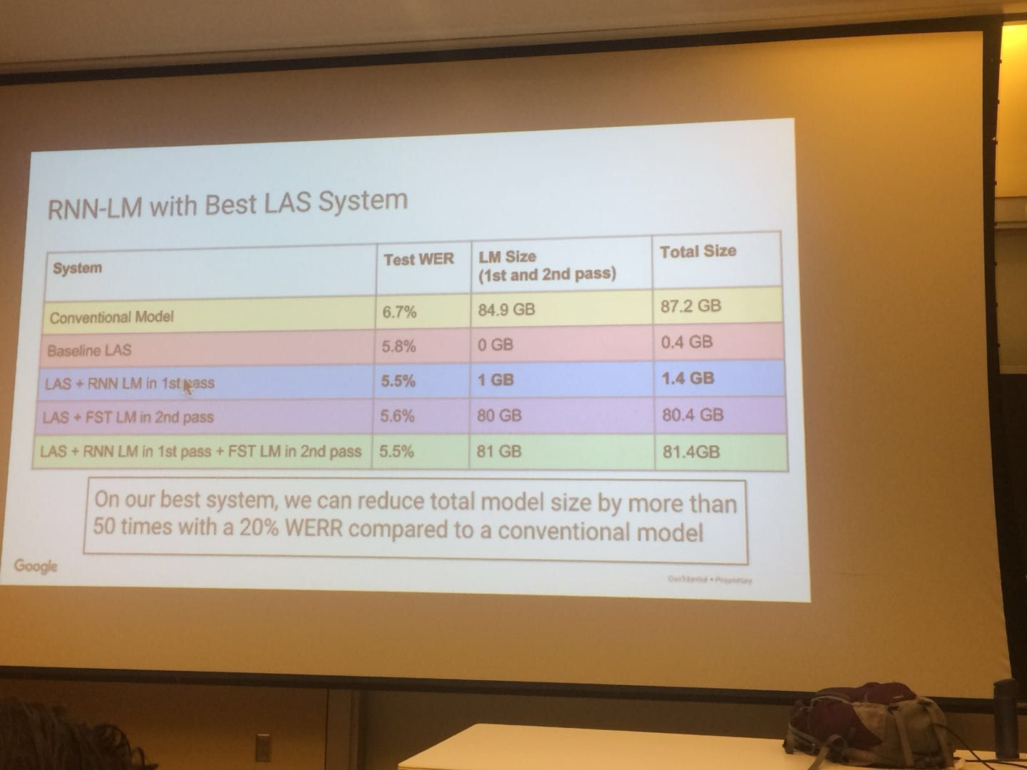
Streaming E2E Models

Slide 7
Streaming E2E Models
Google’s E2E Research
2017: 不同端到端模型对比 (LAS最优，RNNT略差) ；
2018: E2E SOTA结果 (LAS) + 性能改进(mWER、LM fusion) + 模型压缩 + Contextual ASR + Multilingual;
2019: On-device (RNNT)+ Others (contextual、semi-supervised、multilingual、spell correction);
2020: Two-Pass E2E (Interspeech19 - )
Current challenges and existing drawbacks
LAS is even better than hybrid systems, but is difficult on streaming
RNNT (ICASSP19, On-Device) is good on streaming, so the companies follow the RNNT work, including Facebook, Microsoft and Tencent, etc
But there is still a performance gap comparing RNNT to LAS

Slide 8
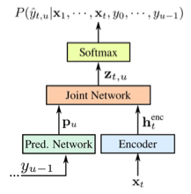
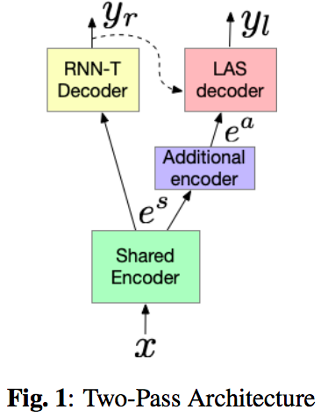
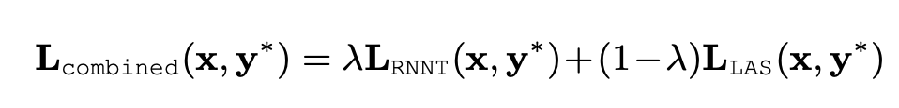
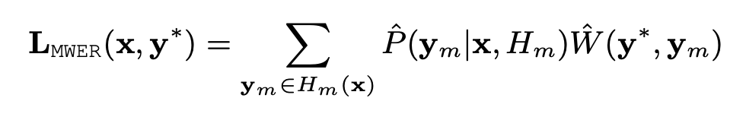
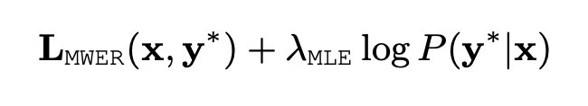
Google’s Two Pass Model (IS2019/ICASSP2020)
Multi-step Training
RNNT Training
Frozen encoder & LAS Training
Joint Training
mWER Training

Slide 9
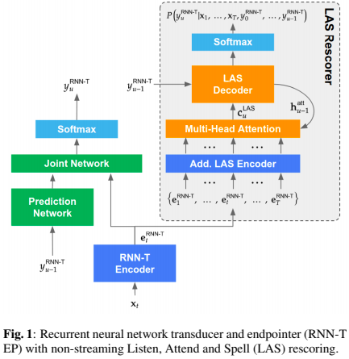
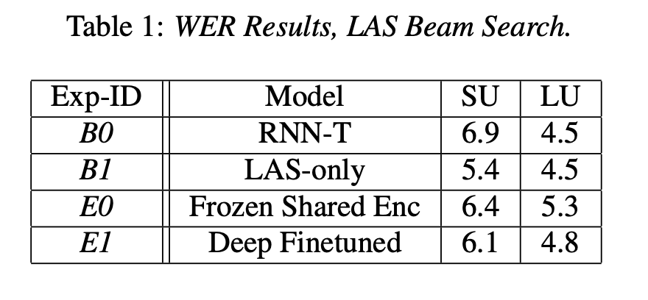
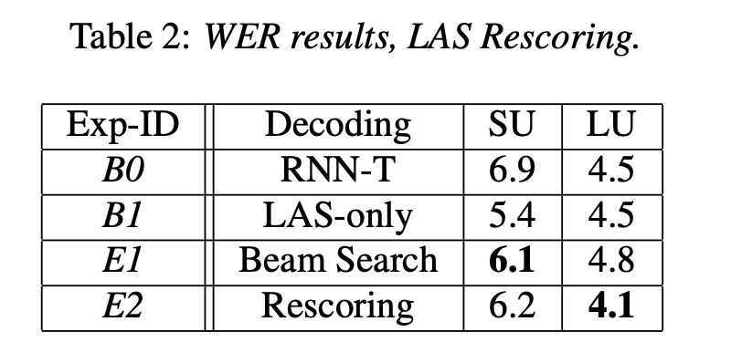
Google’s Two Pass Model
Two Decoding Strategies
LAS Decoder Beam Search
15% Improvements over RNNT on Short Utterances (< 5.5s)
But Performance Degrades on Long Utterances (> 5.5s)
LAS Decoder Rescore (Utilize Acoustic Info, stronger than LM)

Slide 10
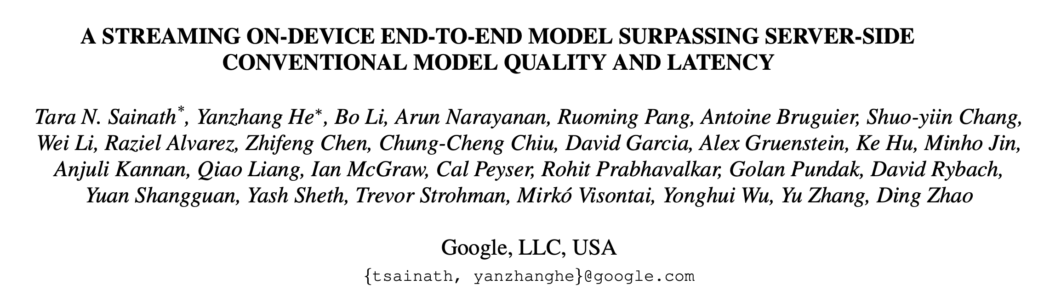
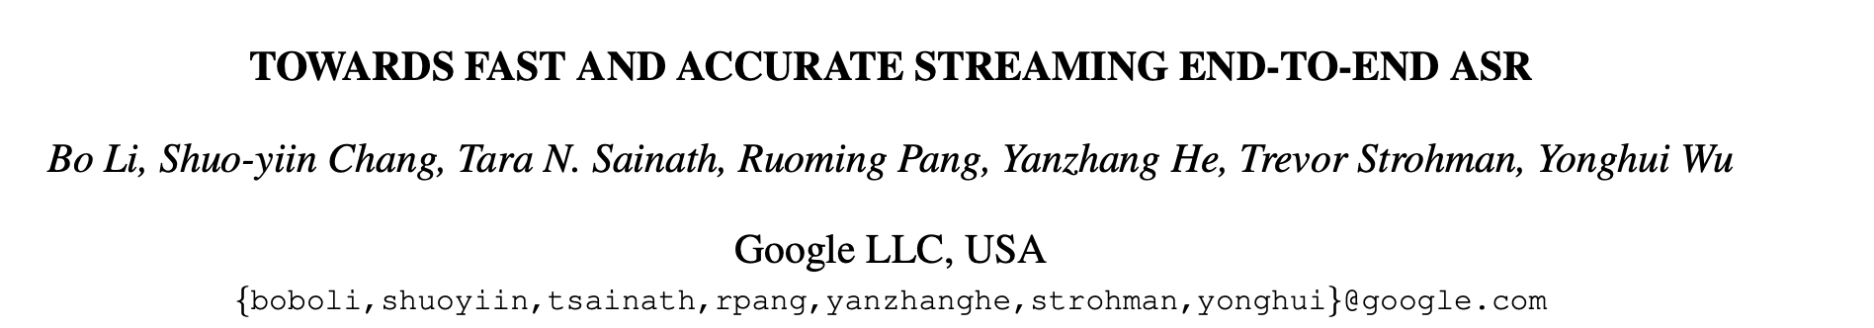
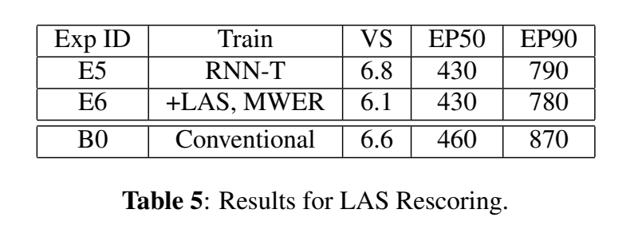
Google’s Two Pass Model

Slide 11
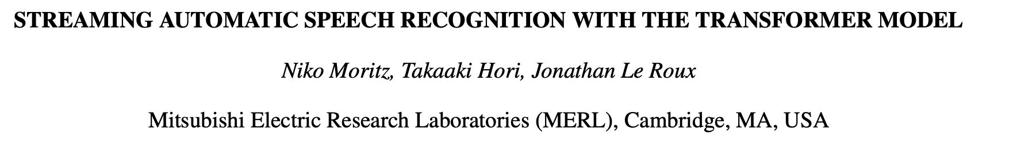
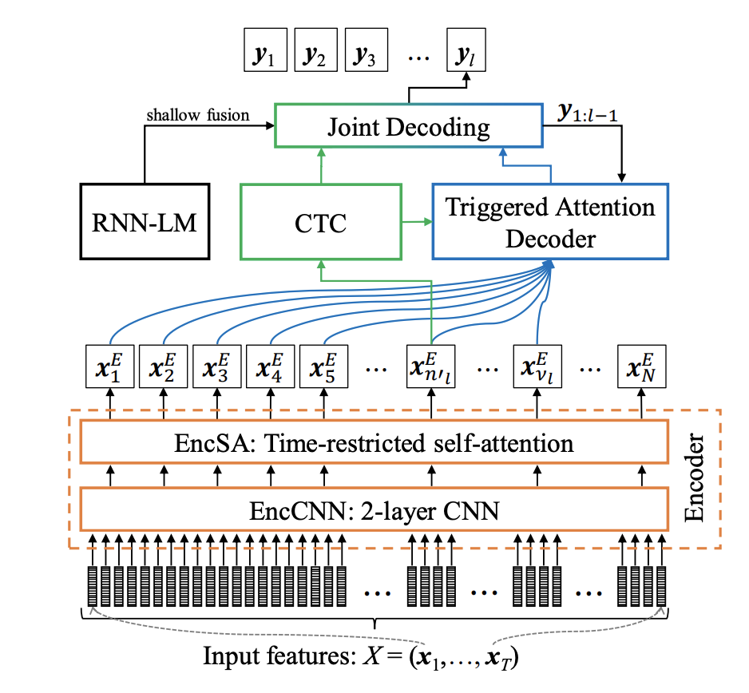
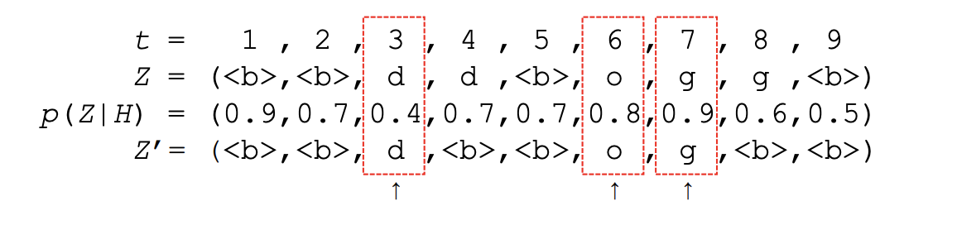
Triggered Attention (MERL)
Triggered Attention is applied on the Transformer, with the Joint CTC-Attention：
Time-restricted self attention in encoder, look-ahead
Triggered Attention: using CTC-spike to cut chunk, and Decoder ouputs one token within one chunk
ground-truth label is used to get chunk in training (the alignment with the most probability), and decoding uses frame-synchronous prefix beam search

Slide 12
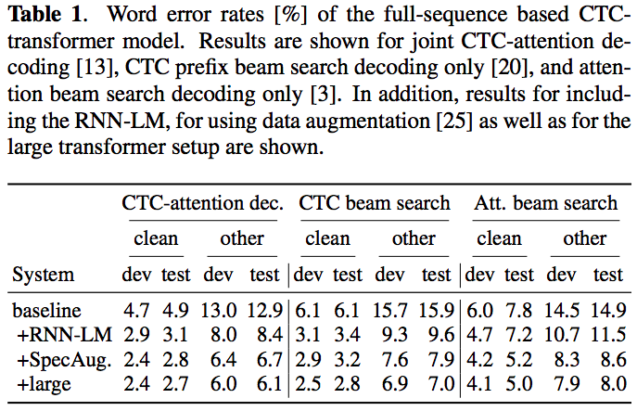
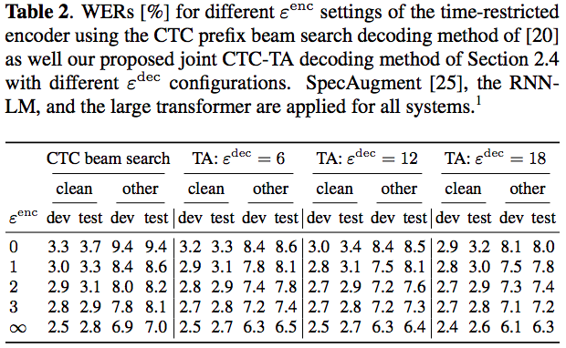
Triggered Attention (MERL)

Slide 13
End-to-End ASR
New Models (6 Papers) + General Topics (12 Papers)
2篇Incorporate external text data (NTU, Google);
1篇Synthesized speech data for Improving performance (RWTH TTS data)
3篇Semi-supervised (Google consistency loss, NTT speech-chain, Facebook filtering)
2篇Multi-speaker E2E ASR (JHU、Google: Transformer / RNNT separately)
4篇模型结构 (Nvidia纯CNN、3篇Transformer结构探索)
1篇Non-autoregressive iterative refinement
2篇研究RNNT behavior (RNNT decoder可以用MLP、用Hybrid Alignment协助训练)
1篇Speaker Adapt.
HAT(HYBRID AUTOREGRESSIVE TRANSDUCER)
Others

Slide 14
Adaptation
1 Session, 12 Papers
3 Speaker Adaptation (vector-based, TTS, KL-regularization)
1 Attention-based gated scaling (AGS)
2 Domain Adaptation (KD with multiple teacher)
3 Children, Accent, dysarthric
2 Semi-supervised/ unsupervised (unsupervised cross-lingual transfer, multi-genre)
1 Dataset: Libri-Adapt, unsupervised domain adaptation. 7200hr and 72 domains, and recorded on mobile and embedded-scale microphones in the real scenarios

Slide 15
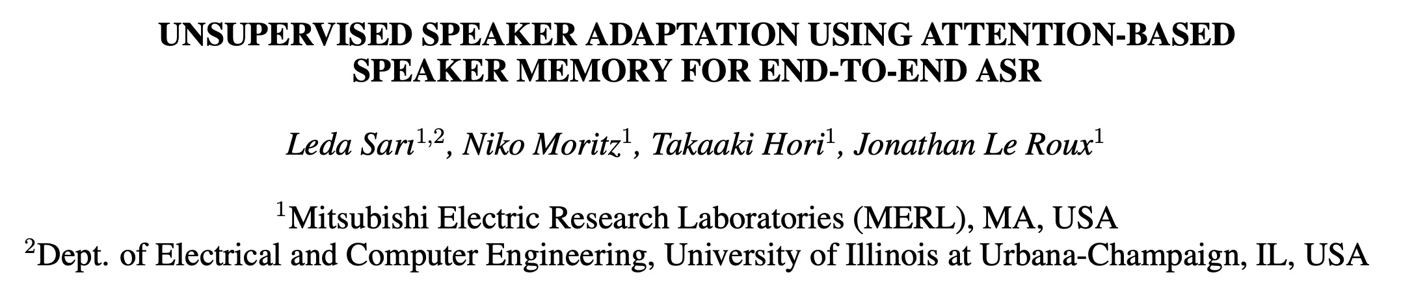
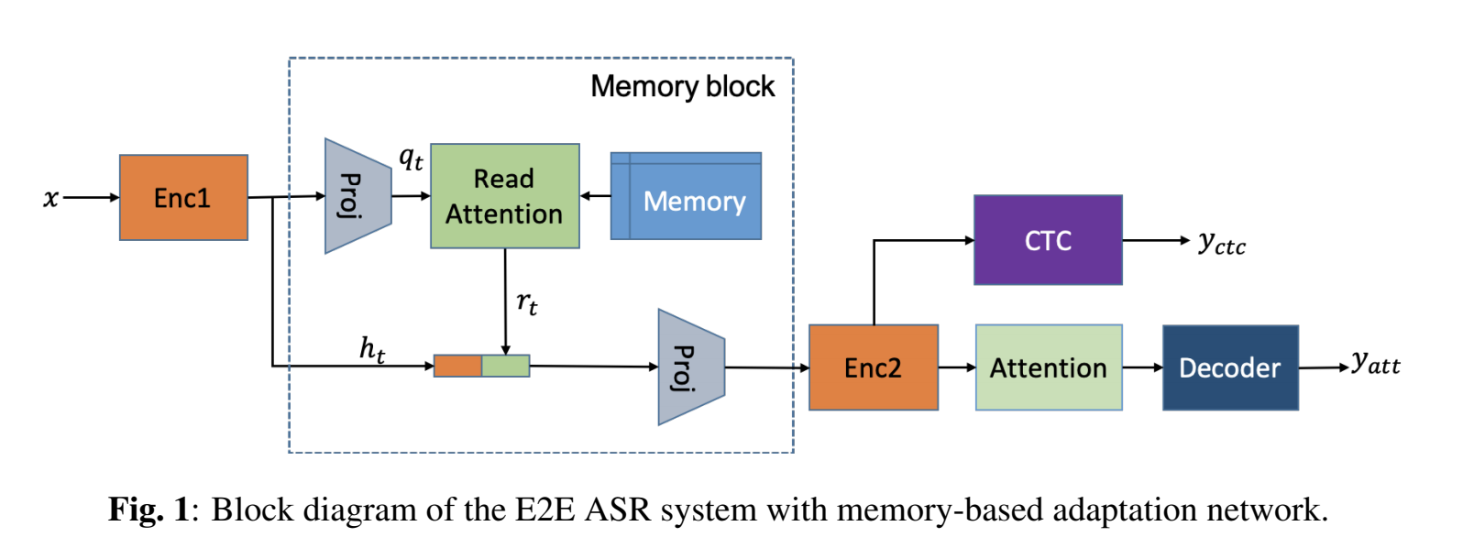
Memory block holds speaker i-vectors extracted from the training data
Read relevant i-vectors from the memory through an attention mechanism
M-vector replaces i-vector
All neural network, no need to extract i-vector at evaluation stage
Frame-wise Adaptation (online adaptation?)

Slide 16
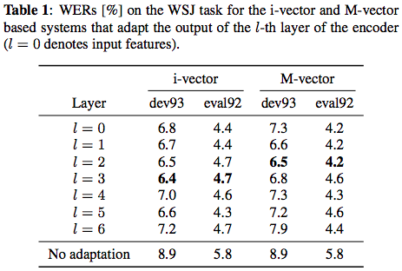
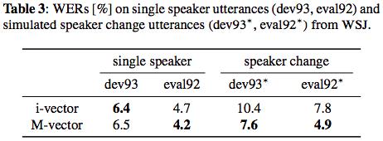
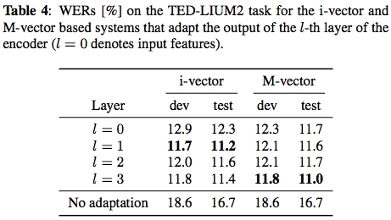
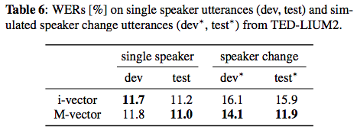
Achieve the similar WER as i-vector in single-speaker utts
Significantly outperform i-vector for the multi-speaker change utts

Slide 17
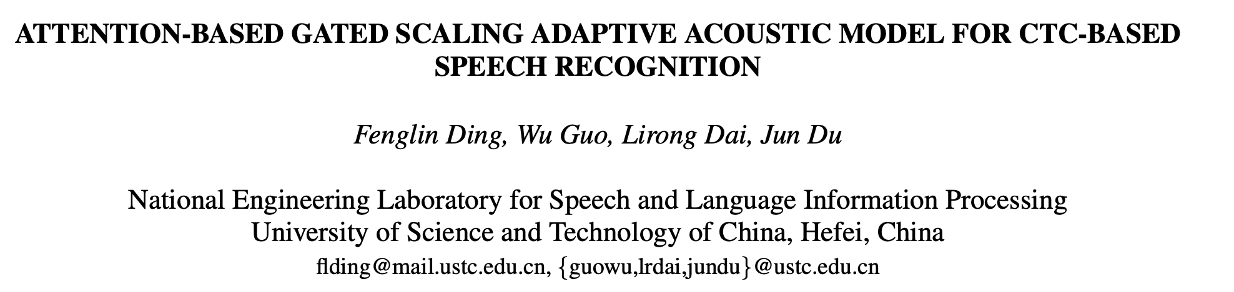
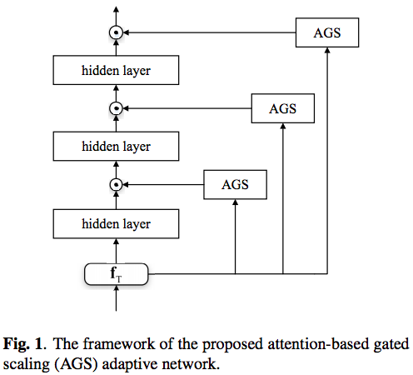
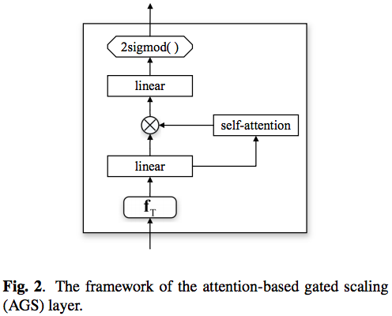
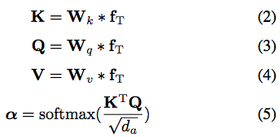
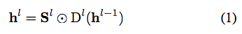
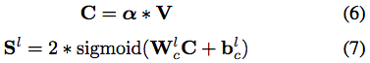
Outputs of each hidden layer are scaled by an auxiliary gate matrix from a AGS layer
The AGS layer and the main network are jointly trained without a second-pass

Slide 18
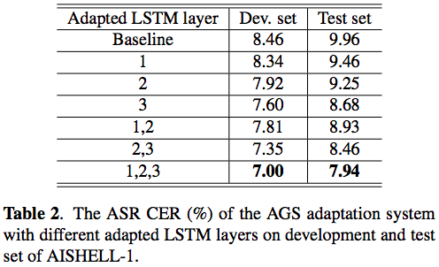
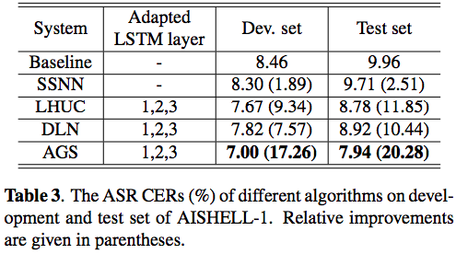
Significantly better than the baseline
Outperform three typical adaptation algorithms for conventional hybrid systems

Slide 19
Robust
1 Session, 12 Papers
Noise-robust/far-field/accent/multi-talker/multi-channel
6 using E2E arch
2 using multi-modal (audio-visual)
2 Data augmentation/simulation
2 Adversarial training
3 Multi-talker overlapped speech

Slide 20
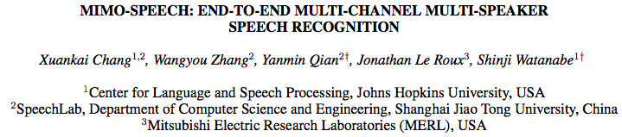
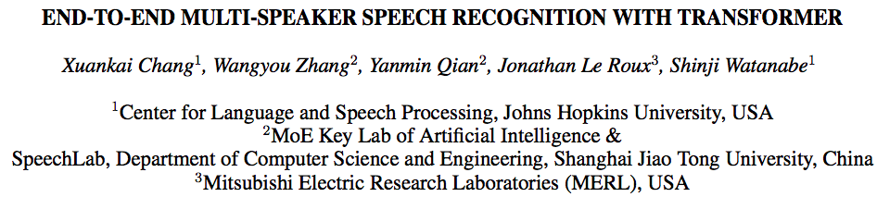
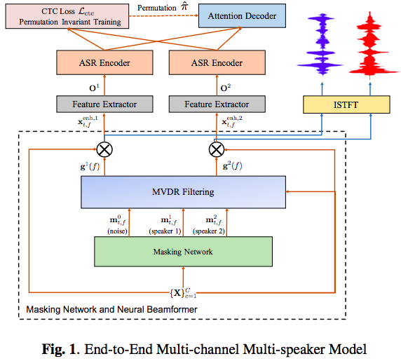
MIMO-Speech
From Single-channel to Multi-channel
From Single-speaker to Multi-speaker
Multi-channel Input & Multi-speaker Output
MIMO Speech + End-to-End
Architecture
Monaural Mask Network
Multi-Source Neural Beamformer
End-to-end Speech Recognition
All module can be either RNNs or Transformers
Training
Permutation-free training
Data Scheduling
Curriculum Learning
Features
The whole model is differentiable and can be optimized with an ASR loss
Perform speech separation even without explicit signal reconstruction criterion

Slide 21
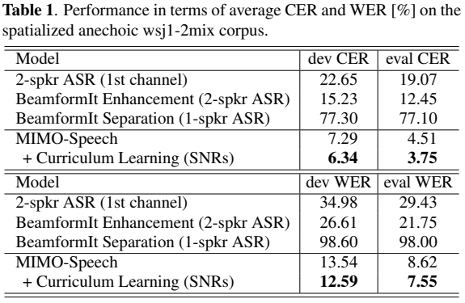
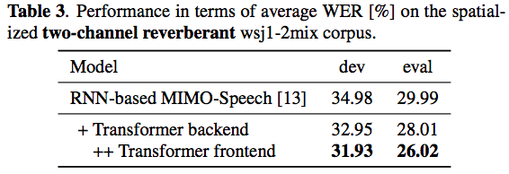
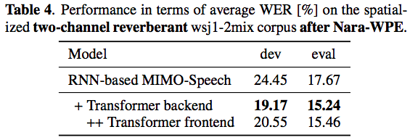
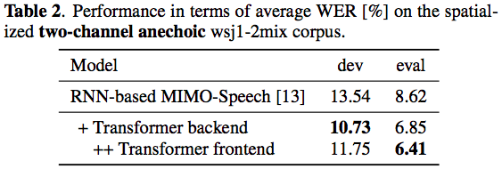
The MIMO-Speech with Transformer still works well in the reverberant scenarios
MIMO-Speech is much better than the single-channel system for the overlapped speech
The MIMO-Speech can be combined with Nara-WPE in the front-end and obtain further improved performance in the reverberant scenarios
The performance gap is largely reduced between the anechoic and reverberant conditions
Transformer works better on both back-end and front-end in MIMO-Speech architecture

Slide 22
General Topics on Acoustic Model
3 Session, 36 Papers
9 Model Structure (3 CNN，4 Transformer, 2 LSTM)
Towards deeper and faster network
5 Unsupervised / semi-supervised / self-supervised training
Utilizing unpaired data (NLP BERT)
……

Slide 23
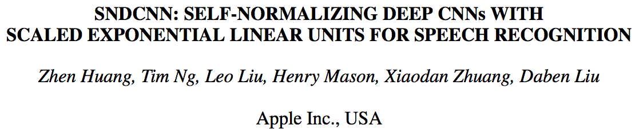
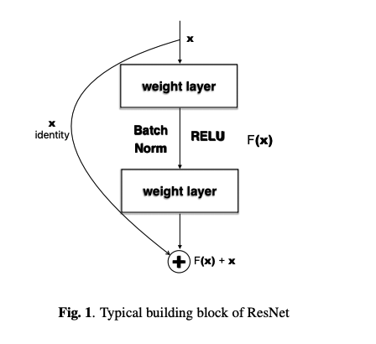
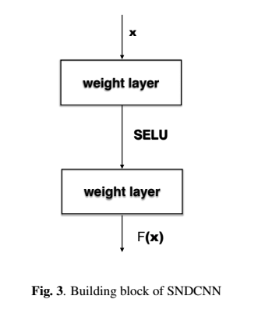
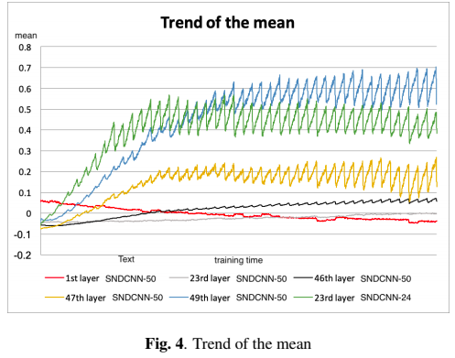
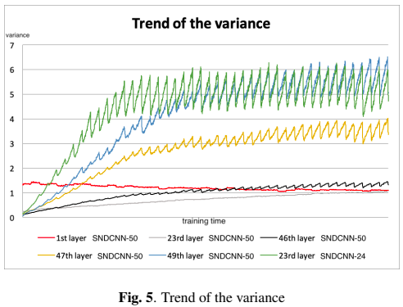
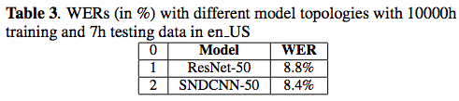
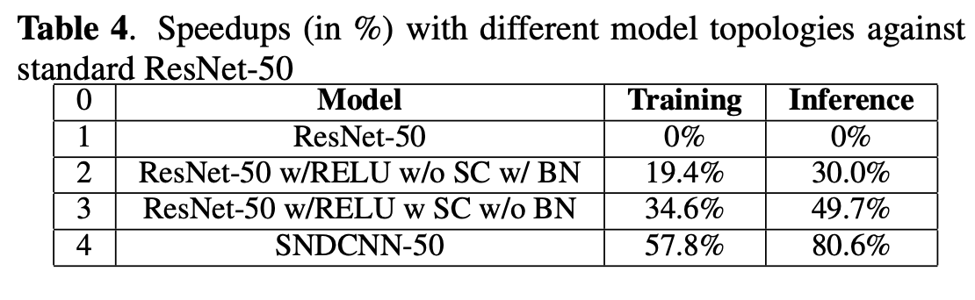
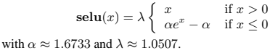
VDCNN is good, but difficult to train. So SC and BN are added
Self-normalizing NN’s neuron activations automatically converges towards zero mean and unit variance
SELU-scaled exponential linear unit
Replace SC & BN with SELU, no performance degradation (slight improvement), while maintaining the ability of training very deep network
Remove SC & BN with SELU improves training & inference speed a lot

Slide 24
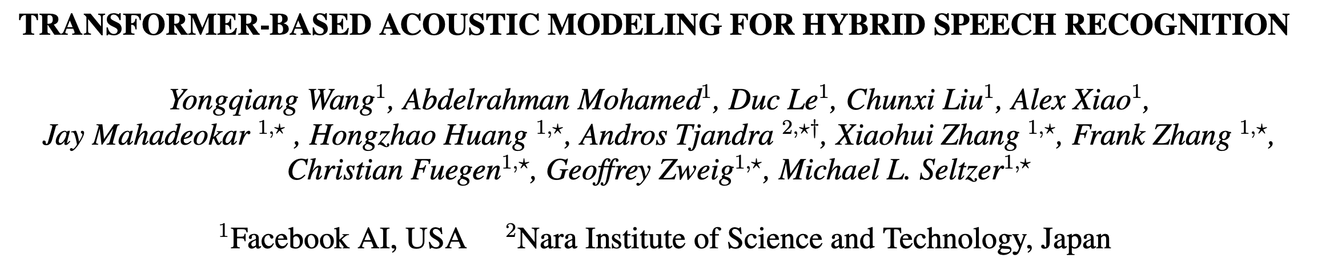
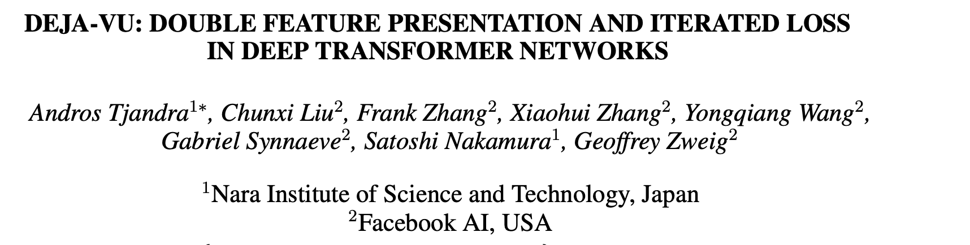
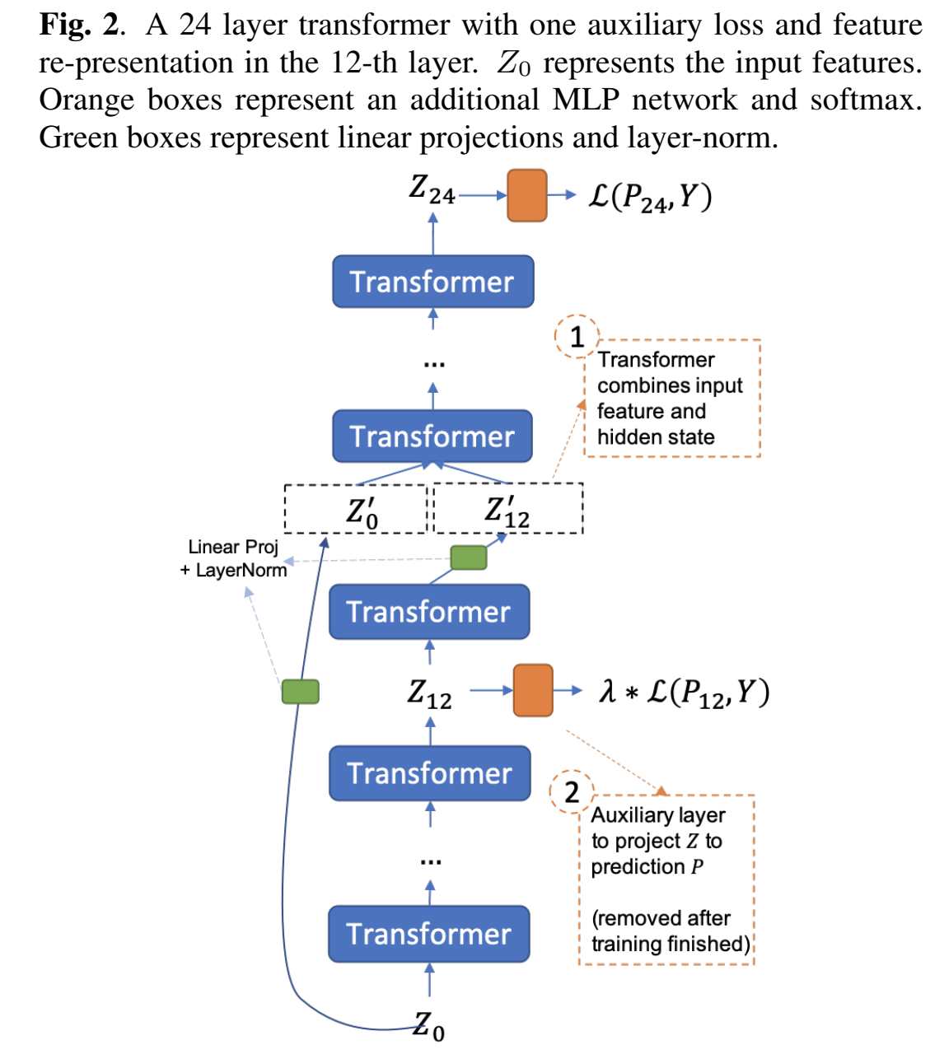
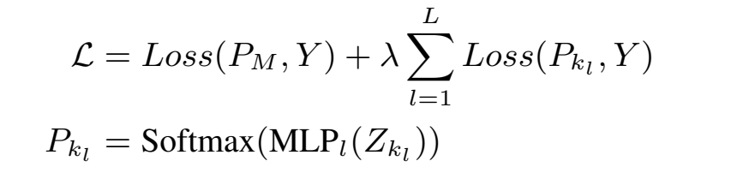


Towards deeper transformer model
1. Iterated Loss
2. Feature Re-presentation:

Slide 25


Improved performance of deep transformer structure for both E2E & Hybrid on two datasets
It can be observed relative 10-20% improvement for Librispeech and 10% for videos

Slide 26







Layer norm (along feature dim)
BN alike: fast convergence, deeper network
vs BN:1) poor estimation if the batch size is not large enough; 2) avoid batch computing (stable & multi-gpu)
Global Norm (GN)
Layer norm LSTM:
Global Joint Norm (GJN)
Per Gate Norm (PGN)
Cell Norm (CN)

Slide 27


LN improves the WER, the stability during training, allows to train deeper models, requires less hyper-parameter tuning, and works well even without pre-training
Global Joint Norm (GJN) performs the best for e2e asr, and give a 10% relative improvement on WER

Slide 28




Pretraining by masked reconstruction
Only f + additional-softmax is retrained on supervised data
Unsupervised pre-training is additive to supervised data augmentation
mT=mF=0: Auto-encoder
T-F Mask-reconstruct outperforms AE method
Pretraining is helpful when supervised set is small

Slide 29
Other recommendations
Machine Learning for Language Processing
Integrating discrete and neural features via mixed-feature trans-dimensional random field language models (Tsinghua University)
HOW MUCH SELF-ATTENTION DO WE NEED? TRADING ATTENTION FOR FEED-FORWARD LAYERS (RWTH)
Confidence, Errors and OOVs
Speech Recognition: CONFIDENCE ESTIMATION FOR BLACK BOX AUTOMATIC SPEECH RECOGNITION SYSTEMS USING LATTICE RECURRENT NEURAL NETWORKS, Errors and OOVs (Cambridge)
ASR ERROR CORRECTION AND DOMAIN ADAPTATION USING MACHINE TRANSLATION (CMU)
Representations and Embeddings
MOCKINGJAY: UNSUPERVISED SPEECH REPRESENTATION LEARNING WITH DEEP BIDIRECTIONAL TRANSFORMER ENCODERS (National Taiwan University)
WHAT DOES A NETWORK LAYER HEAR? ANALYZING HIDDEN REPRESENTATIONS OF END-TO-END ASR THROUGH SPEECH SYNTHESIS(ENCODERS (National Taiwan University)
Word Spotting
INTEGRATION OF MULTI-LOOK BEAMFORMERS FOR MULTI-CHANNEL KEYWORD SPOTTING (Tencent)
ADAPTATION OF RNN TRANSDUCER WITH TEXT-TO-SPEECH TECHNOLOGY FOR KEYWORD SPOTTING (Microsoft)
TRAINING KEYWORD SPOTTERS WITH LIMITED AND SYNTHESIZED SPEECH DATA (Google)
Large Vocabulary Continuous Speech Recognition and Search
MULTISTATE ENCODING WITH END-TO-END SPEECH RNN TRANSDUCER NETWORK (Google)
FULL-SUM DECODING FOR HYBRID HMM BASED SPEECH RECOGNITION USING LSTM LANGUAGE MODEL (RWTH)

Slide 30
Thank You

